Slide 1

INTELLIGENT SYSTEMS • TASK 1
Warehouse Delivery Robot
S . . # .
# # * # .
. . * * G
Search Algorithms Report
UCS vs. A*
S = Start G = Goal
* = Selected path

Slide 2
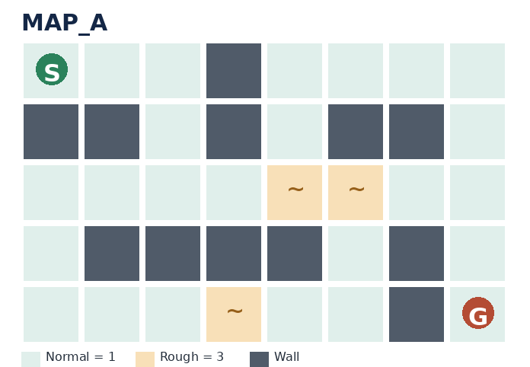
1. Problem Formulation
What the robot must solve
• Find a path from start cell S to goal cell G on a grid.
• The robot moves one cell at a time: Up, Down, Left, or Right.
• Walls (#) cannot be entered.
• Normal floor (.) costs 1; rough floor (~) costs 3 to enter.
• The start cell is not charged. Entering the goal costs 1.
• The implementation scans the map to find S and G.
S/G
.
Start / Goal
Normal • cost 1
~
#
Rough • cost 3
Wall • blocked
Intelligent Systems • Task 1 • Warehouse Delivery Robot 2

Slide 3
2. Search Algorithms
Both algorithms are implemented without a path-finding library
Uniform Cost Search (UCS)
A* Search
• Expands the frontier node with the lowest cost so far, g(n).
• Uses a priority queue (heap).
• Finds a least-cost path when movement costs are non-negative.
• Ranks nodes using f(n) = g(n) + h(n).
• g(n) is the cost already paid; h(n) estimates the remaining distance.
• The code uses Manhattan distance as h(n).
Manhattan distance: |row − goal_row| + |column − goal_column|
Intelligent Systems • Task 1 • Warehouse Delivery Robot 3

Slide 4
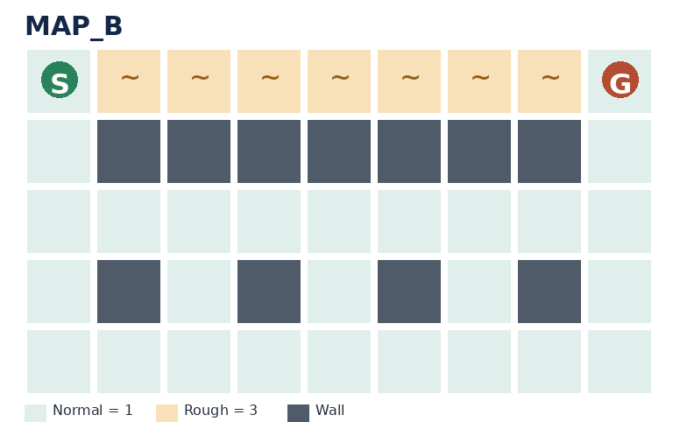
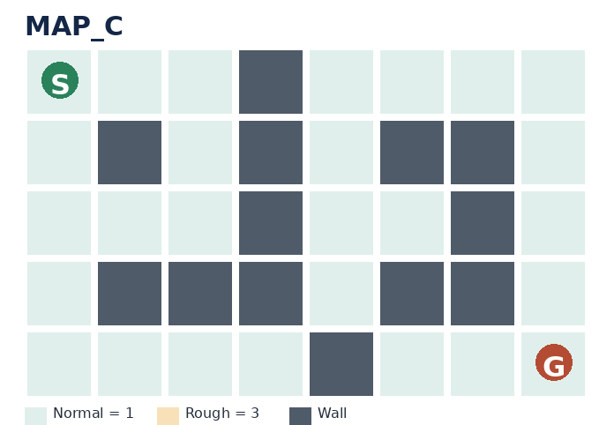
3. Test Maps
The three maps provided in the task
MAP_A
MAP_B
MAP_C
Reachable goal with rough cells
A short but expensive top route
No valid path
The code runs both UCS and A* on every map.
Intelligent Systems • Task 1 • Warehouse Delivery Robot 4

Slide 5
4. Results Table
Values collected by running the submitted omar.py implementation
Map | Algorithm | Moves | Cost | Expanded | Max frontier | Time (s)
MAP_A | UCS | 11 | 15 | 27 | 4 | 0.000066
MAP_A | A* | 11 | 15 | 20 | 5 | 0.000042
MAP_B | UCS | 12 | 12 | 29 | 4 | 0.000046
MAP_B | A* | 12 | 12 | 14 | 7 | 0.000027
MAP_C | UCS | N/A | N/A | 13 | 3 | 0.000019
MAP_C | A* | N/A | N/A | 13 | 3 | 0.000020
Run time is machine- and run-dependent; the displayed times are from one execution.
Intelligent Systems • Task 1 • Warehouse Delivery Robot 5

Slide 6
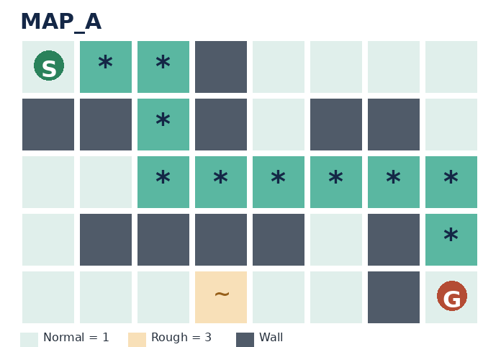
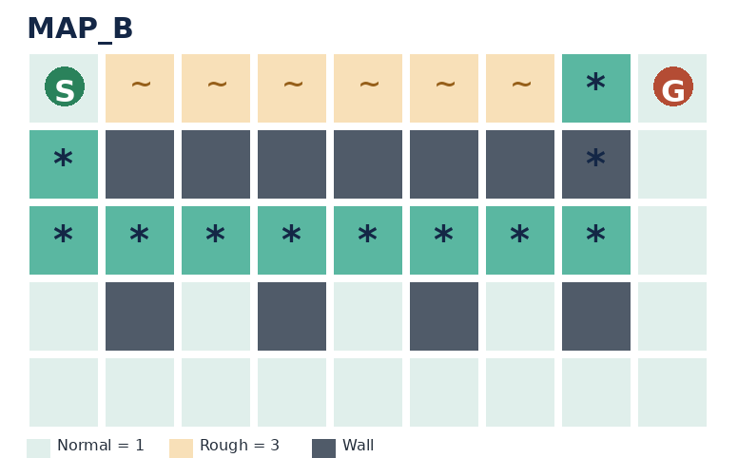
5. Path Visualisation
Asterisks (*) mark the selected path; S and G remain visible
MAP_A
MAP_B
MAP_C
Cost = 15 • 11 moves
Cost = 12 • 12 moves
No path found
UCS returns the same optimal costs and path lengths for these maps.
Intelligent Systems • Task 1 • Warehouse Delivery Robot 6

Slide 7
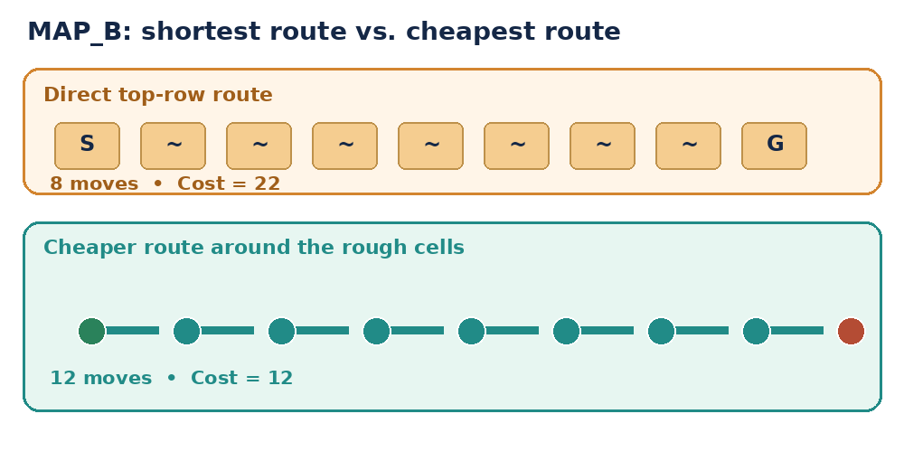
6. Comparison and Discussion
What the results show
• Path cost: UCS and A* found the same costs on MAP_A (15) and MAP_B (12).
• MAP_B trap: the direct top-row route takes 8 moves but costs 22; the chosen route takes 12 moves and costs 12.
• Nodes expanded: A* expanded fewer nodes on MAP_A (20 vs. 27) and MAP_B (14 vs. 29).
• MAP_C: both algorithms correctly reported that no path exists.
• Choice: A* is a good choice for this robot because it found the same least costs while expanding fewer nodes on the two solvable maps.
MAP_C: both algorithms expanded 13 nodes; no path exists.
Intelligent Systems • Task 1 • Warehouse Delivery Robot 7

Slide 8
7. Test Cases Summary
Full test case descriptions are provided in the separate Test Cases document
ID | Input | Expected / verified result | Status
TC-01 | MAP_A | UCS and A* find path; cost 15 | Pass
TC-02 | MAP_B | Cheapest route cost 12, not direct cost 22 | Pass
TC-03 | MAP_C | No path found | Pass
TC-04 | S~G | Path cost = 4 (3 + 1) | Pass
TC-05 | S.G | Path cost = 2 | Pass
TC-06 | S#G | No path found | Pass
TC-07 | Missing S or G | Search returns no path | Pass
Intelligent Systems • Task 1 • Warehouse Delivery Robot 8

